Slide 1
Elections 2012: What is at stake?
New Jersey State Convention
April 20-21, 2012

Slide 2
What “they” have done and are doing….

Slide 3
Attacks on Collective Bargaining

Slide 4
Pension and Benefits

Slide 5
Vouchers

Slide 6
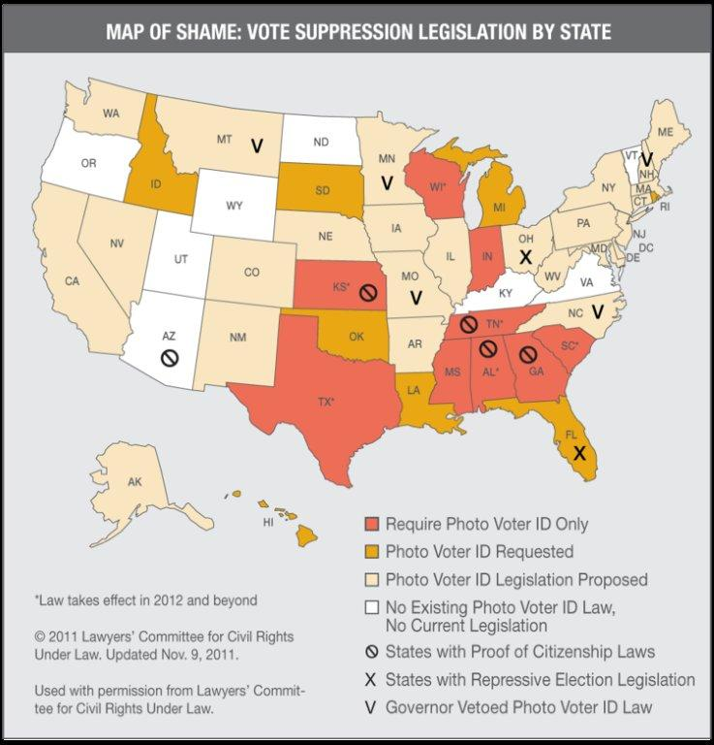

Slide 7
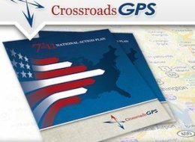
$100M STATE BATTLES
“Two conservative groups founded last year with the help of Republicans Karl Rove and Ed Gillespie have set a goal of raising $120 million in the effort to defeat President Barack Obama, win a GOP majority in the Senate and protect the party's grip on the House in the 2012 election.”
--WSJ, Mar 1, 2011

Slide 8
Congressional Job Approval

Slide 9
2012 U.S. Senate Races
Current Senate Lineup: 53-47
51 Democrats
47 Republicans
2 Independents (both caucus with Dems)
23 Democratic seats up for election (vs. 10 Republican seats)
7 Democratic seats are toss ups
3 Republican seats are toss ups
3 seats lean Democratic

Slide 10
Senate Races to Watch
Democratic Toss Up Seats
Daniel Akaka, HI
(Open)
Claire McCaskill, MO
Jon Tester, MT
Kent Conrad, ND
(Open)
Jeff Bingaman, NM (Open)
Jim Webb, VA
(Open)
Herb Kohl, WI
(Open)

Slide 11
Senate Races to Watch
Lean Democratic Seats
Bill Nelson, FL
Debbie Stabenow, MI
Sherrod Brown, OH
Republican Toss Up Seats
Olympia Snowe, ME
(Open)
Scott Brown, MA
vs. Elizabeth Warren
Dean Heller, NV
vs. Rep. Shelly Berkley

Slide 12
2012 Electoral Vote
270 Electoral Votes needed to win
Solid D (15 states, 186 EV)
CA (55), CT (7), DE (3), HI (4), IL (20), ME (4), MD (10), MA (11), NJ (14), NY (29), OR (7), RI (4), VT (3), WA (12),
DC (3)
Likely D (1 state, 5 EV)
NM (5)
Lean D (2 states, 14 EV)
MN (10), NH (4)

Slide 13
2012 Electoral Vote
270 Electoral Votes Needed to Win
Toss Up (10 States – 142 EV)
Dem Base 205
Need 65
CO (9) OH (18)
Fl (29) PA (20)
IA (6) VA (13)
MI (16) WI (10
NV (6) NC (15)

Slide 14
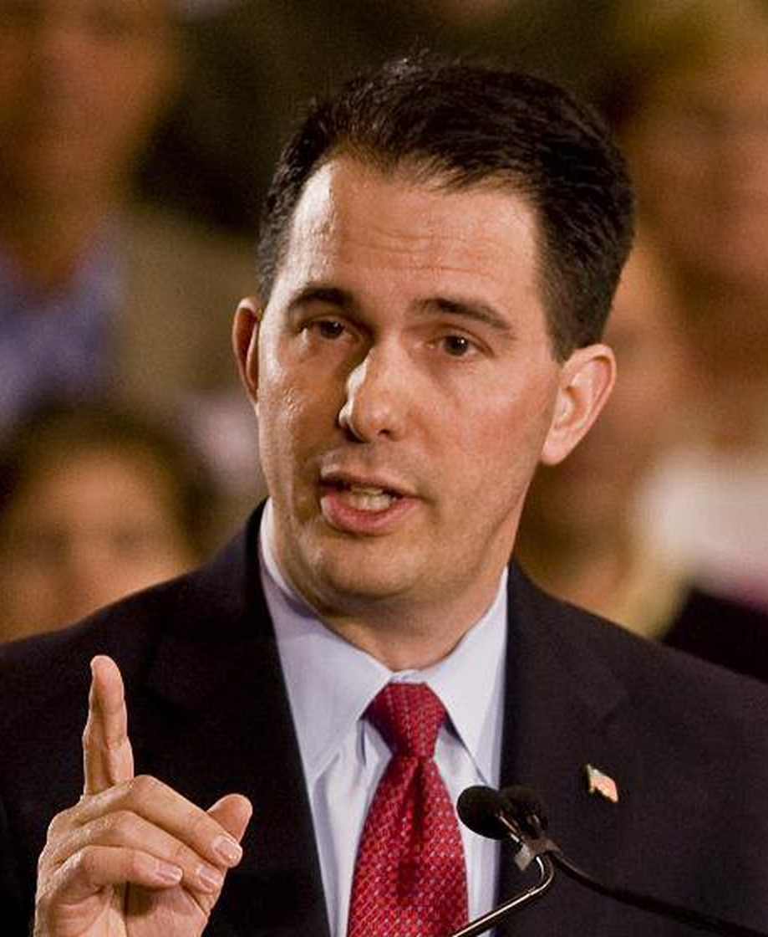
2012 Governors
RECALL GOVERNOR SCOTT WALKER:
WI
AFL-CIO

Slide 15
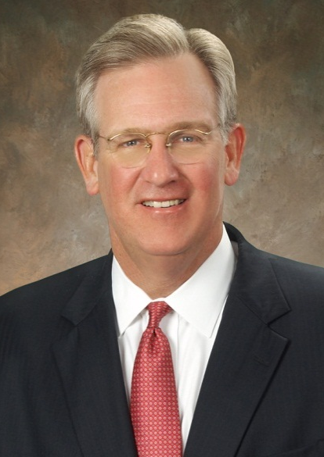
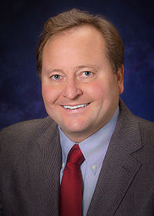
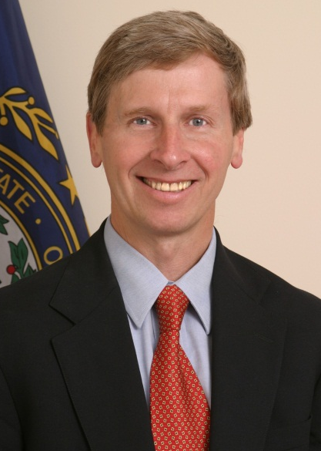
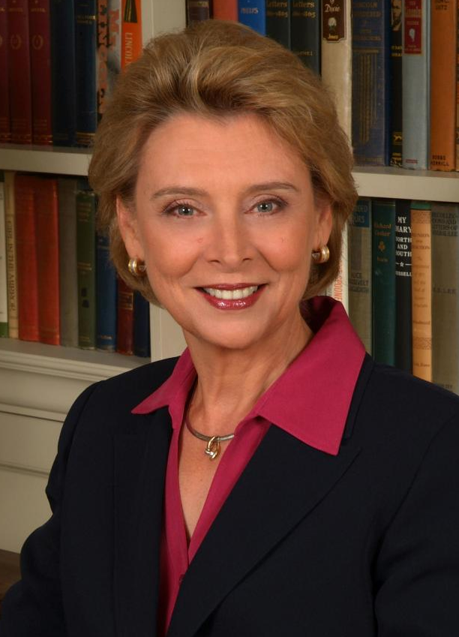
2012 Governors
COMPETITIVE RACES
HOLD FOUR STATES WHERE GOVERNORS ARE KEEPING ANTI-WORKER LEGISLATION FROM BECOMING LAW:
SEEKING RE-ELECTION
TERM-LIMITED
RETIRING
RETIRING
Jay Nixon (MO)
Brian Schweitzer
(MT)
John Lynch (NH)
Chris Gregoire
(WA)
AFL-CIO

Slide 16
2012 State Legislatures
PREVENT ANTI-WORKER LEGISLATION
BY HOLDING STATE LEGISLATURES:
State | Chamber | Current Majority
Nevada | Senate | 1
Iowa | Senate | 2
Oregon | Senate | 2
AFL-CIO

Slide 17
STOP ANTI-WORKER LEGISLATION
BY TAKING BACK STATE LEGISLATURES:
State | Chamber | # Seats for Majority
Colorado | House | 1
Oregon | House | 1
Wisconsin | Senate | 1
New York | Senate | 3
Maine | House | 3
Montana | Senate | 3
Maine | Senate | 3
Minnesota | Senate | 4
Minnesota | House | 5
Pennsylvania | Senate | 5
Michigan | Senate | 7
New Hampshire | Senate | 7
Michigan | House | 8
Florida | Senate | 8
Ohio | House | 10
Indiana | House | 10
Florida | House | 21
AFL-CIO

Slide 18
Labor Ballot Measures

Slide 19
What the Republican Presidential Candidates Are Saying

Slide 20
Mitt Romney
“I have taken on union bosses before; I’m happy to take them on again.” Feb 2012
“If we want jobs, we have to be right to work.” Feb 2012
“Right to work makes sense for New Hampshire and for the nation.” Jan 2012

Slide 21
Rick Santorum
“…but the idea that the federal government should be running schools, frankly much less that the state government should be running schools is anachronistic.” Feb 2012
“I do not believe that state, federal or local workers should be involved in unions.” Sept 2011

Slide 22
Newt Gingrich
“We bought the mistake of thinking that the teacher’s unions actually care about kids when clearly they only care about protecting bad teachers.” Feb 2012

Slide 23
Ron Paul
“Once government union bosses gain “bargaining power” over government workers, the idea of providing taxpayers with the best service at the lowest cost goes out the window.” Sept 2011
“The near monopoly control over the indoctrination of young people in our public school systems is counterbalanced by homeschooling, private schooling and education readily available on the Internet.” Apr 2011

Slide 24
What President Obama Is Saying

Slide 25
President Obama
It was the labor movement that helped secure so much of what we take for granted today. The 40-hour work week, the minimum wage, family leave, health insurance, Social Security, Medicare, retirement plans. The cornerstones of the middle-class security all bear the union label. (9/06/10)
It was because I believed in you. I placed my bet on the American worker. And I’ll make that bet any day of the week. (UAW Speech, 3/12)

Slide 26
President Obama
“Some of what I've heard coming out of Wisconsin, where you're just making it harder for public employees to collectively bargain generally seems like more of an assault on unions,” 2/17/11
"Let's certainly not blame public employees for a financial crisis that they had nothing to do with. And let's not use this as an excuse to erode their bargaining rights. So whether it's Wisconsin, the state of Ohio, I strongly disapprove." 3/27/11

Slide 27
AFT Obama Endorsement

Slide 28
President Randi Weingarten on Obama Endorsement
“This election is a choice, not a referendum. It’s a choice between very different economic visions for our country and, and at stake is the simply yet powerful notion that everyone deserves a fair chance to achieve the American dream.” Feb 2012

Slide 29
President Randi Weingarten on Obama Endorsement
“Although we have not always agreed with President Obama’s specific education policies, we share a common core belief that the health of our economy and the quality of our public education system always have been and always will be intertwined.”

Slide 30
AFT Endorsement Process
Surveyed AFT membership
Talked directly with AFT members and leaders soliciting their opinions
Reviewed candidate records and positions on our issues
Created Elections Matter section on AFT Website with candidate information and issues

Slide 31
AFT Obama Endorsement
Included information on candidates and issues in all AFT publications
Ongoing dialogue with state/local leaders and members on challenges facing our members and the country
Used the AFT E-activist network to solicit membership input on issues
Budget super committee
American Jobs Act
Positions of the Republican presidential candidates

Slide 32
Political Landscape in New Jersey 2012 and Beyond…

Slide 33
New Jersey 2012 Presidential
President Obama | 49%
Romney | 40%
Pres. Obama | 49%
Romney/Christie | 42%

Slide 34
Presidential Results in
New Jersey 2008, 2004, 2000
2008 | Obama 56.8% | McCain 42.1%
2004 | Kerry 52.9% | Bush 46.2%
2000 | Gore 56.1% | Bush 40.3%

Slide 35
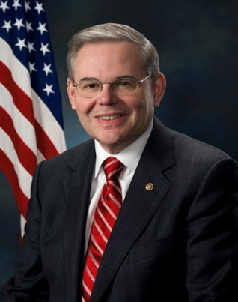
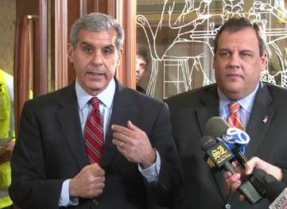
New Jersey US Senate Race 2012
Senator Robert Menendez (D)
Vs.
State Senator Joe Kyrillos (R)

Slide 36
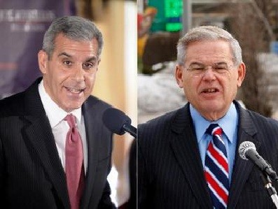
New Jersey US Senate Polling
Poll | Date | Menendez (D) | Kyrillos (R) | Spread
Quinnipiac | 4/3 - 4/9 | 44 | 35 | Menendez +9
Fairleigh Dickinson | 3/5 - 3/11 | 43 | 33 | Menendez +10
SurveyUSA | 2/24 - 2/26 | 46 | 31 | Menendez +15

Slide 37
US Senate Results in New Jersey 2008, 2006, 2002, 2000
2008
Lautenberg (D) | 55.5%
Kean Jr. (R) | 42.5%
2006
Menendez (D) | 53.3%
Kean Jr. (R) | 44.3%
2002
Lautenberg (D) | 53.8%
Forrester (R) | 43.9%
2000
Corzine (D) | 50.1%
Franks (R) | 47.1%

Slide 38
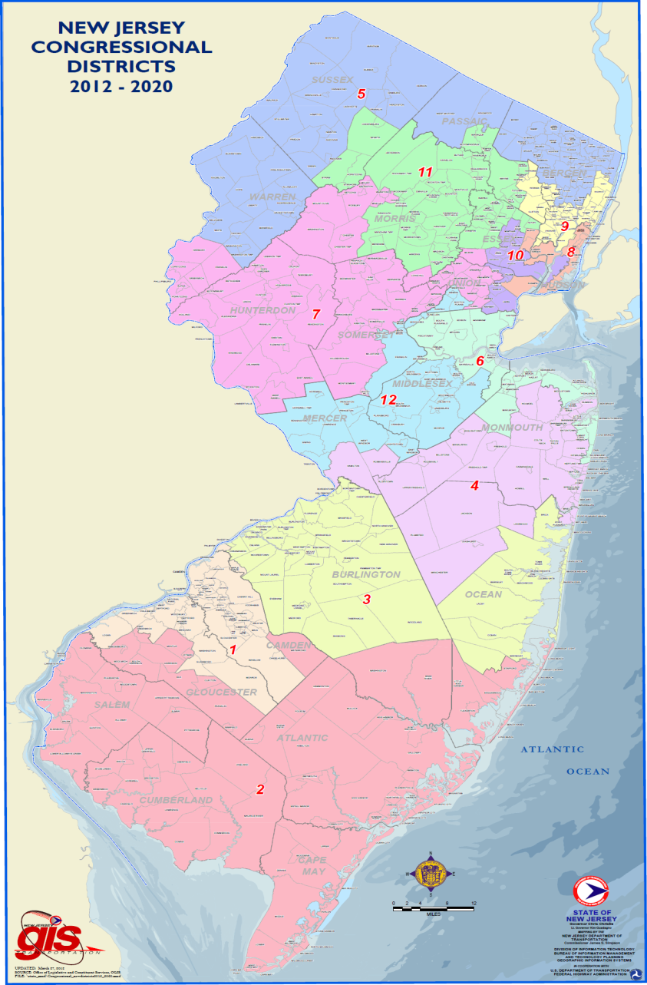
Congressional Races

Slide 39
Congressional Races
CD | Incumbent | %Vote in 2010
1 | Andrews (D) | 63%
2 | Lobiondo (D) | 65.5%
3 | Runyan (R) | 50% | *Shelly Adler (D)
4 | Smith (R) | 69.4%
5 | Garrett (R) | 64.9%
7 | Pallone (D) | 54.7%
8 | Sires (D) |  | *New District– Pascrell won in 2010 with 62.7%

Slide 40
Congressional Races Cont…
CD | Incumbent | %Vote in 2010
9 | Rothman /Pascrell (D) |  | *New District
10 | Open (D) | Payne Sr. Won in 2010 85.2% | *Contested Democratic Primary
11 | Frelinghuysen (R) | 67.2%
12 | Holt (D) | 53%

Slide 41
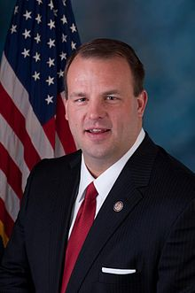
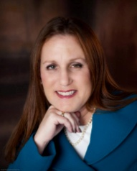
Congressional Race
Rep. Jon Runyan (R)
vs.
*Shelly Adler (D)
District | AFT Density | Local (Proximity)
CD 3 | 667 | Rutgers Camden AAUP Rutgers Camden URA Rowan Stockton TCNJ

Slide 42
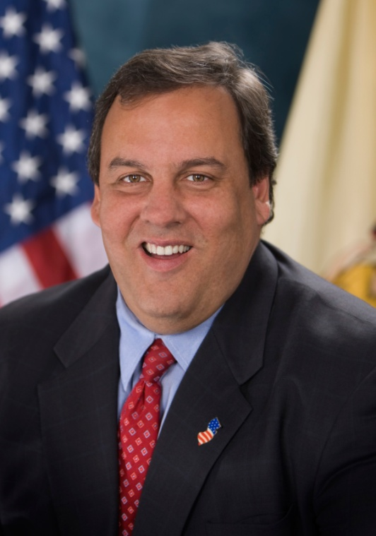
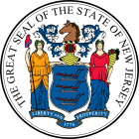
Can you imagine this…
2013-2017
Chris Christie
Governor of New Jersey

Slide 43
Governors Race 2009
Christie (R) | 48.46% | 1,174,445
Corzine (D) | 44.88% | 1,087,731
Daggett (I) | 5.7% | 139,579

Slide 44
AFT by the Numbers...
New Jersey | AFT | Registered to Vote
Members | 43,385 | 32,000
Household | 77,881 | 43,180
Totals | 121,266 | 75,180
2009 Gubernatorial | % Voted
Members | 66.5%
Household | 47.4%
Total Universe | 55.5%

Slide 45
Governors Race 2009
Chris Christie won by only 86,714 votes
33.5% AFT Members did NOT Vote
52.6% AFT Household Members did NOT Vote
*There are over 500,000 Public employee union members in the State of New Jersey

